Slide 1
Ruby Blocks
Plus
Test Driven Performance Monitor with Stubs

Slide 2
Blocks
A block is an anonymous function.
my_array.each do |value|
do_something(value)
end

Slide 3
Block Syntax
{ |x| puts x}
is the same as:
do |x|
puts x
end
Notes:
two ways to declare a block
use curly brackets for single lines of code
use do end for multi lines of code

Slide 4
Blocks
def dos_veces
yield
yield
end
dos_veces { puts "Hola” }
Hola
Hola
Yield executes the block
This is a Block!
{
Notes:
What is a block?
It is the ability to take a block of code, wrap it up in an object and pass it to a method.
Then you can run the block of code within the method any time you want…sometimes twice!
The result is kind of like sending a method to a method, except that a block isn’t bound to an object like a method is – it is an object.
So what? Why use blocks?
elegant syntax for iterators
Because there are some things that only blocks can do, like being passed to a method and being returned by a method.

Slide 5
Yield with Parameters
def superpowers
a = “x-ray vision”
b = “flying”
yield(a, b)
end
superpowers do |x,y| puts x,y
end
x-ray vision
flying
Yield sends its parameters as arguments to the block
yield(a,b) sends a and b
to |x, y|
x is set to a
y is set to b

Slide 6
Checking for a Block
def repeat(num)
if block_given?
num.times { puts yield }
else
puts "I can't repeat what you don't tell me"
end
end

Slide 7
Explicit Block Parameter
def repeat_lots(&my_block)
puts "my_block is a #{my_block.class}"
puts my_block.call
puts yield # this does the same thing
puts my_block.call
end

Slide 8
Performance Monitor Example
How it works:
Record Time
Run Code
Report Time Difference
Hmmm… how do we test when time is always changing?

Slide 9
Test Doubles
A Test Double replaces the "real" instance of an object used by the production code with something suitable for the currently running test, but with the same interface
Stubs
Hard-coded values
Mocks
Pre-programmed with expectations
Fail-fast
Test Doubles in general are often called Mock Objects, so be careful about terminology
Fakes
Can store values across calls, but don't really do what the live object would do
E.g. in-memory database

Slide 10
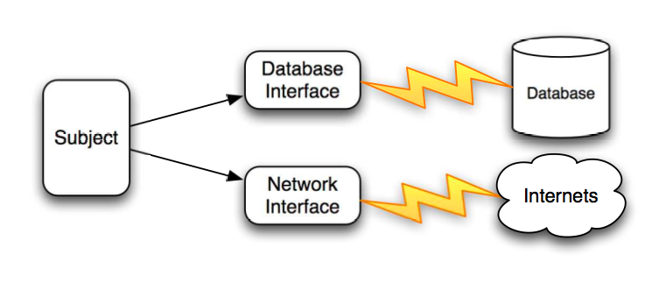
How to Test Code with Dependencies
Example from The Rspec Book by David Chelimsky

Slide 11
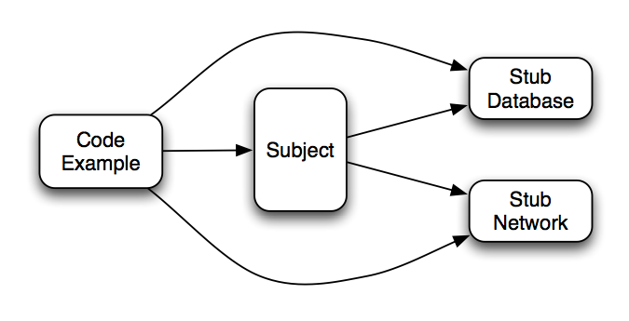
Isolating the Subject
Example from The Rspec Book by David Chelimsky

Slide 12
Stub in RSpec
my_instance.stub!(:msg).and_return(value)
MyClass.stub!(:msg).and_return(value)

Slide 13
Using stub from irb
>> require ‘spec’
>> require ‘spec/mocks’
>>Time.stub!(:now).and_return(10,20)
>>Time.now
10
>>Time.now
20
>>Time.now
20

Slide 14
Using stub from irb
>> fake_time = 0
>>Time.stub!(:now).and_return { fake_time += 10 } >>Time.now
10
>>Time.now
20
>>Time.now
30

Slide 15
Stub in RSpec
my_obj.stub!(:msg).and_return("1",2)
my_obj.stub!(:msg).and_return { ... }

Slide 16
Stub for Specific Values
my_obj.stub!(:msg).with(1).and_return(2)

Slide 17
Stub in RSpec
my_obj.stub!(:msg).and_return { ... }

